Slide 1
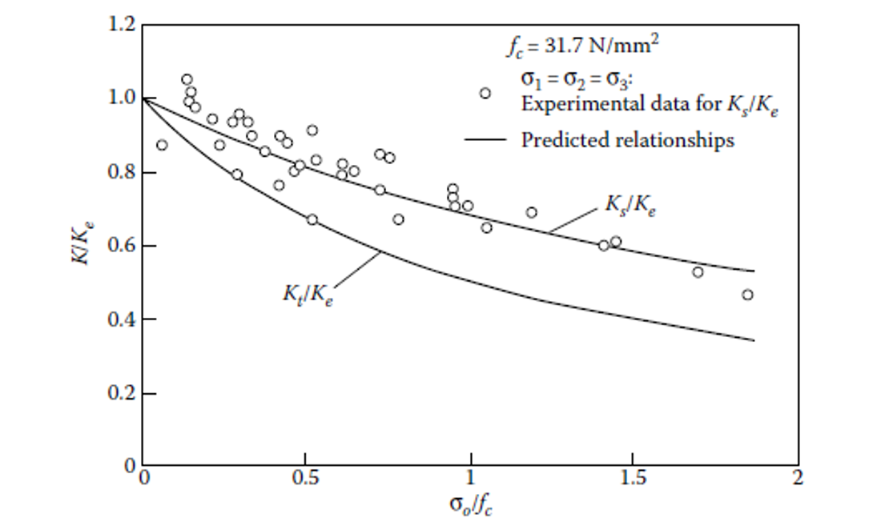
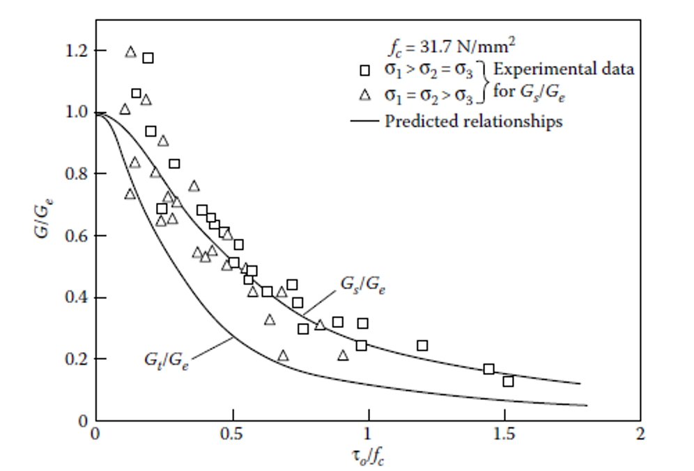
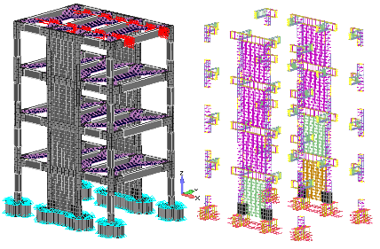
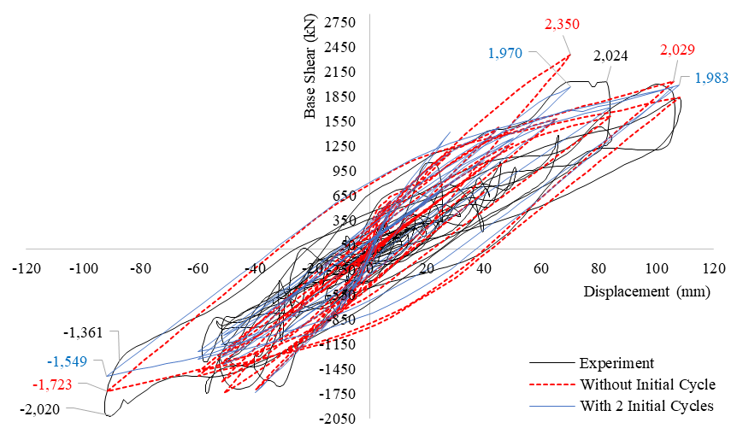
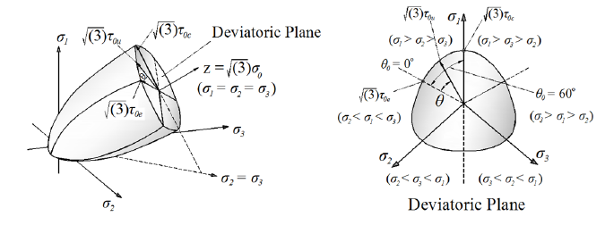
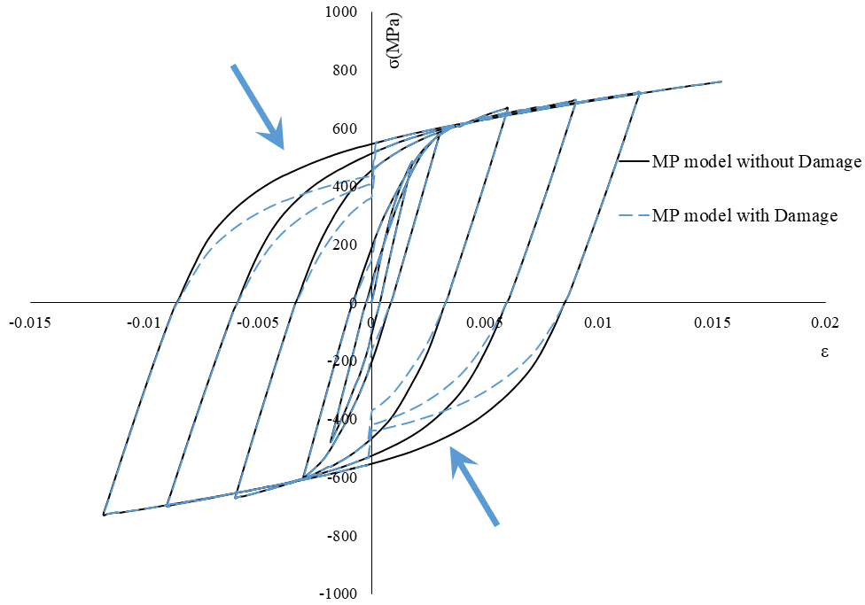
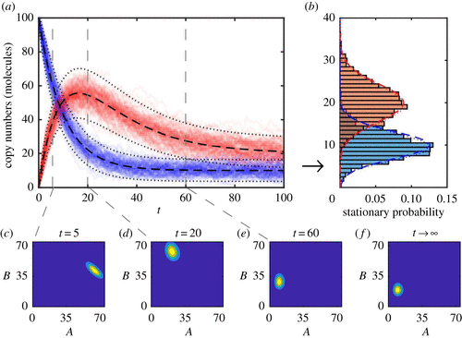
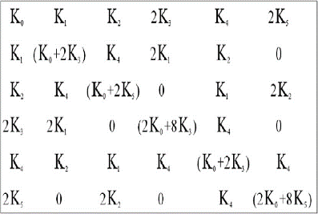
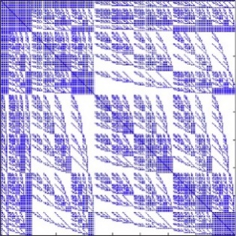
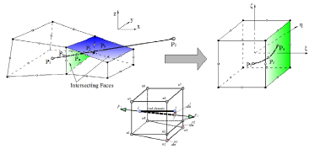
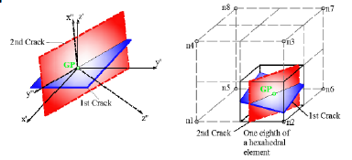
8th ECCOMAS Thematic Conference on Computational Methods in Structural Dynamics and Earthquake Engineering
3D DETAILED MODELLING OF R/C STRUCTURES WITH ACCUMULATED DAMAGE FOR STATIC, DYNAMIC AND STOCHASTIC ANALYSIS
Christos Mourlas* and George Markou
Institute of Structural Analysis & Antiseismic Research, National Technical University of Athens, Greece
____________________________________________________________________________________________________________________________________________
3D Constitutive Material Model for Cyclic Static and Dynamic Behavior.
3D Detailed Modeling of RC Structures.
Static cyclic and dynamic analysis of 3D R/C structures with detailed FE simulation
Stochastic analysis with spectral stochastic FEM and Monte Carlo simulation.
Numerical tests and comparative results on real-scale r/c structures
Achievements
Overview
Detailed modeling of concrete and RC bars
Research Details
Material model for concrete: (Kotsovos and Pavlovits (1995))
Only material parameter is the uniaxial compressive strength
Full-scale 4-story building
Failure criterion-Convex strength
Envelope (Willam & Warkne (1974
Modified Menegotto-Pinto
Steel Model to account for pinching
Analysis with spectral stochastic FEM
Crack Formation-Smeared Crack
approach for concrete
3D Detailed Modeling of RC Structure
(M=2, p=2)
Sparsity pattern (M=6, p=4)
Simulation and inference algorithms for stochastic processes
References

